Slide 1



Basic Features of ParkBench Visual PST Transcript Objects
Bob Cornacchioli
DERO Technical Services
get2bobc@gmail.com
www.derotechnical.com
Mark Messias
ParkBench Software
mark@parkbenchsoftware.com
www.parkbenchsoftware.com

Slide 2

NO MORE RULERS
NO MORE X & Y COORDINATES

Slide 3
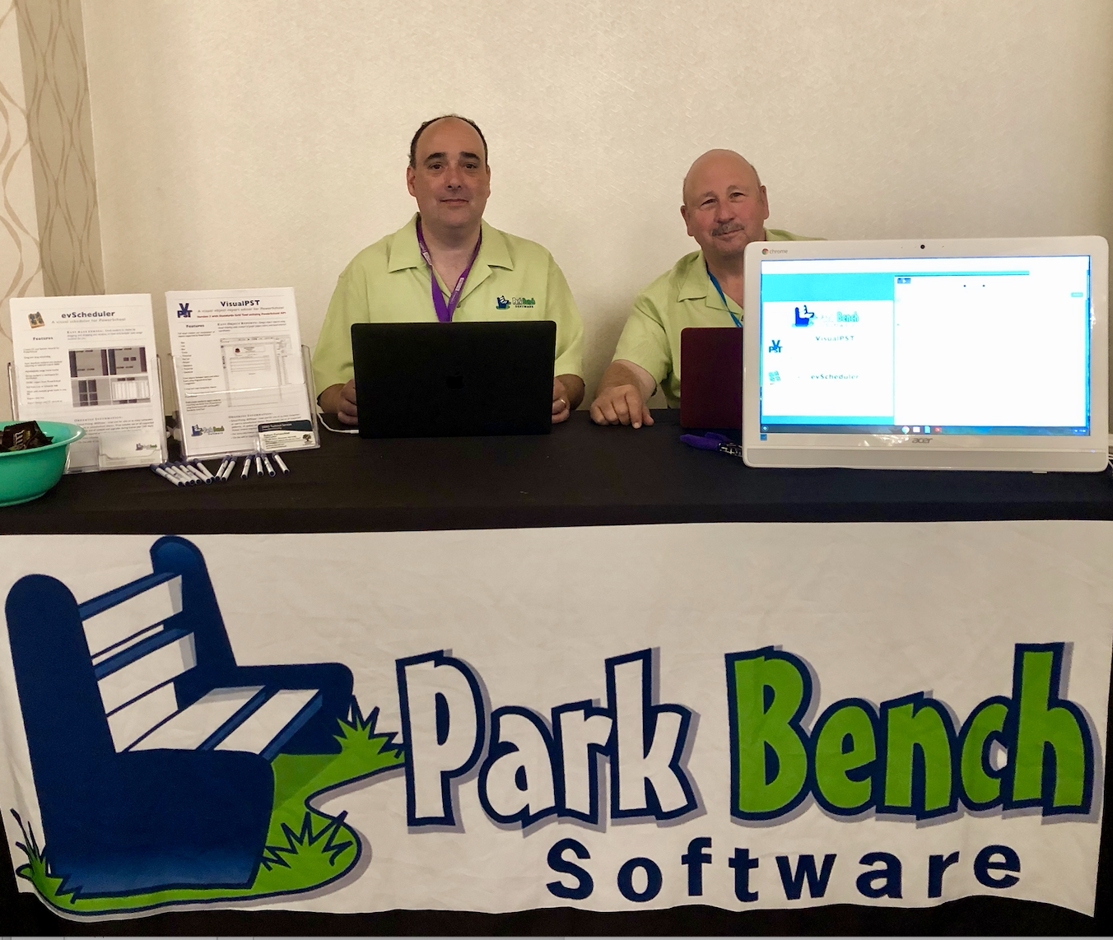
Mark & Bob at PSUG-National in Las Vegas

Slide 4

Agenda/Participants will be engaged in:
Transcript Objects
Boxes/Repeated Lines
Optional field drop downs
Other Field/Text/Format
Play with Width
Filters/Credit Types/Include/Exclude
www.derotechnical.com
for more resources

Slide 5
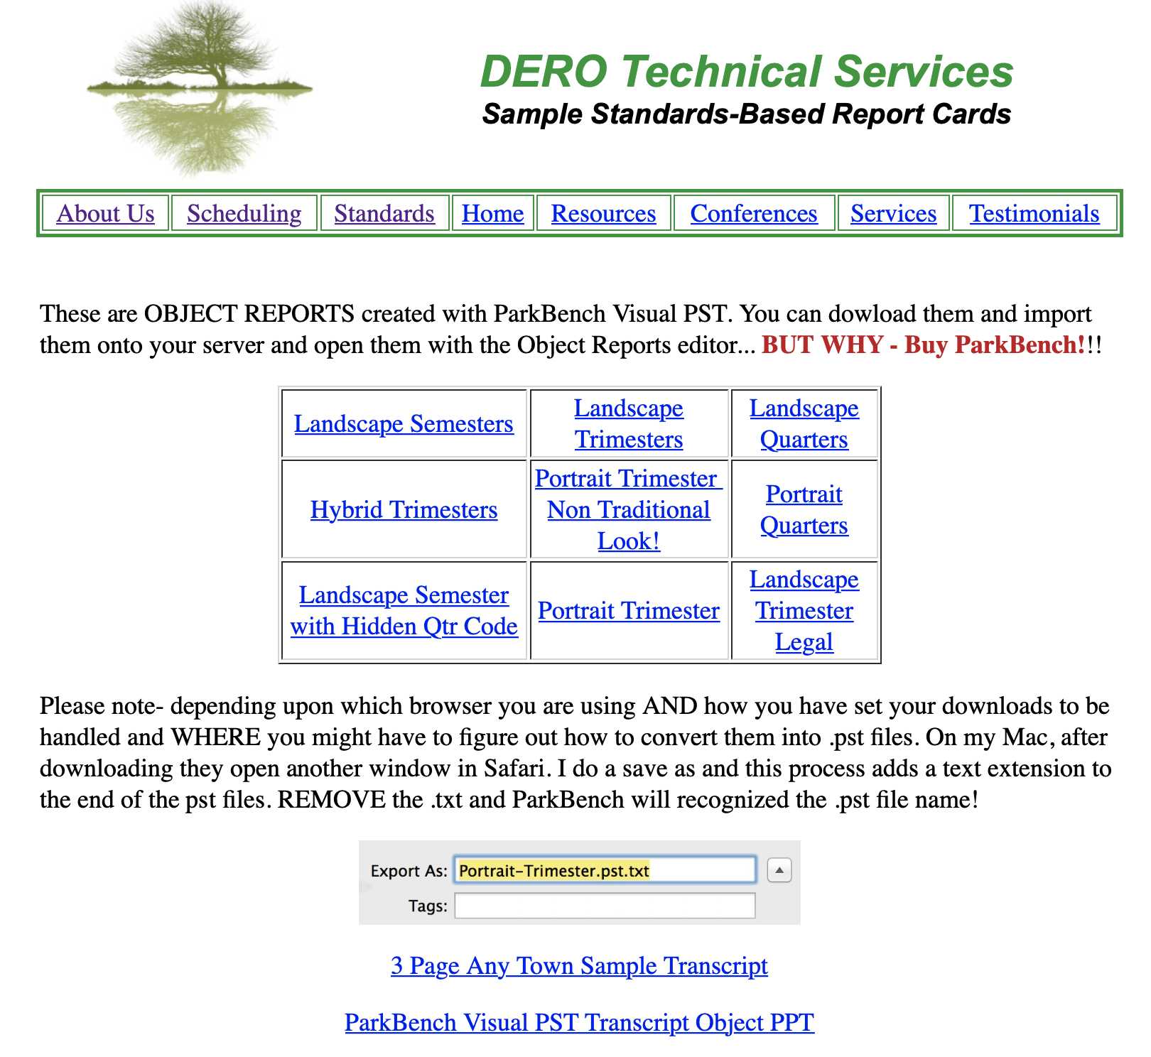
REPORT CARDS - Sample Standards

Slide 6
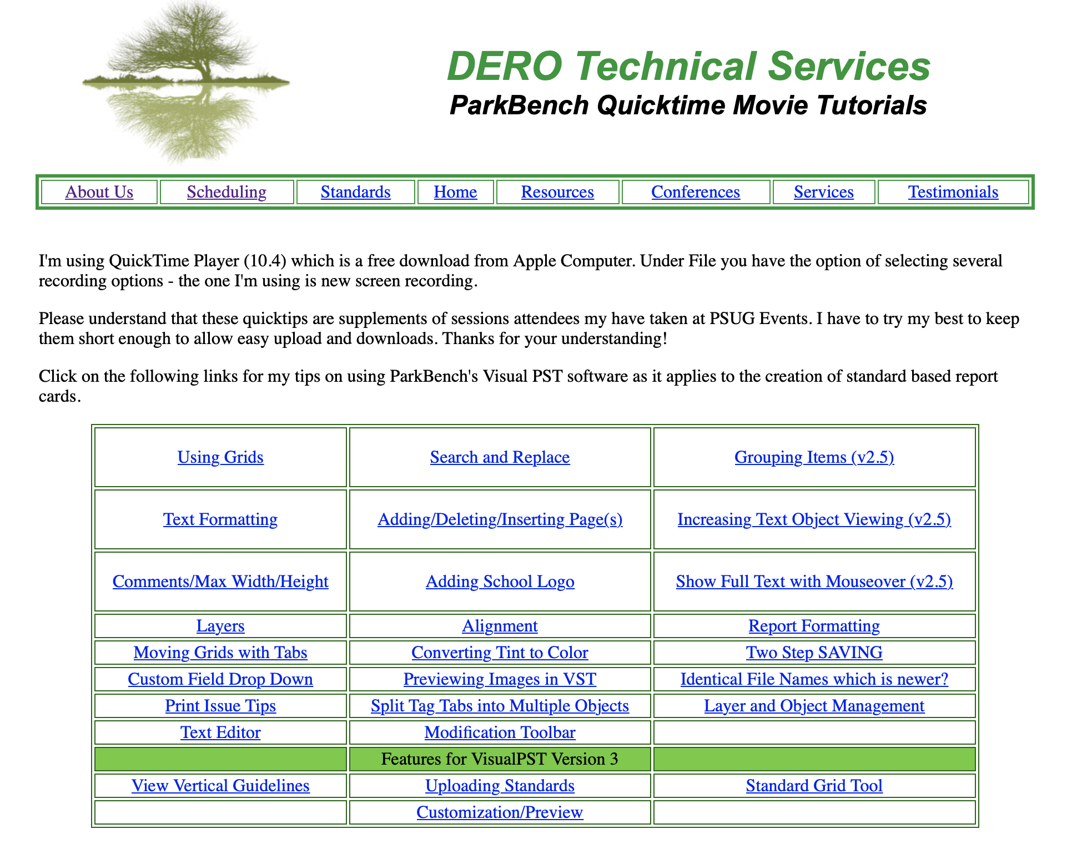
http://www.derotechnical.com/REPORTCARDS/ParkBenchQTMovies.html

Slide 7
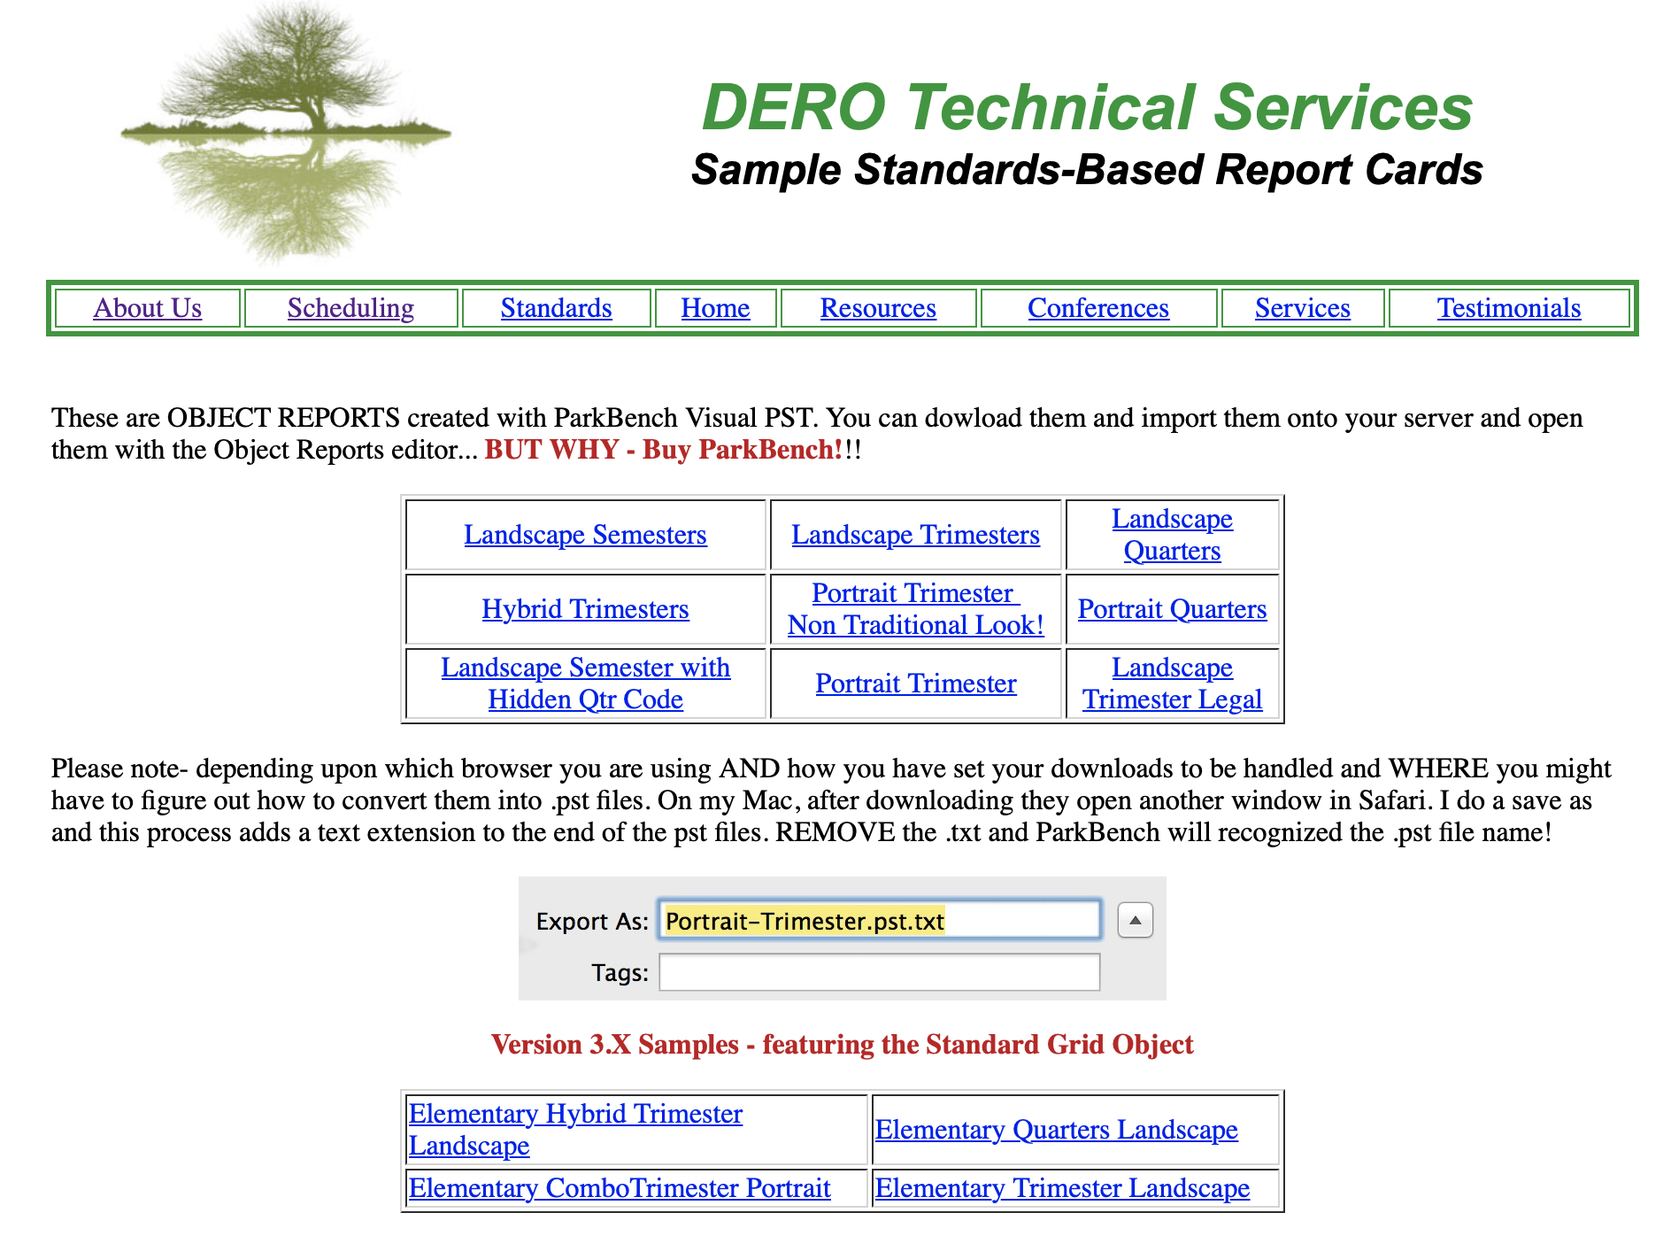

Slide 8
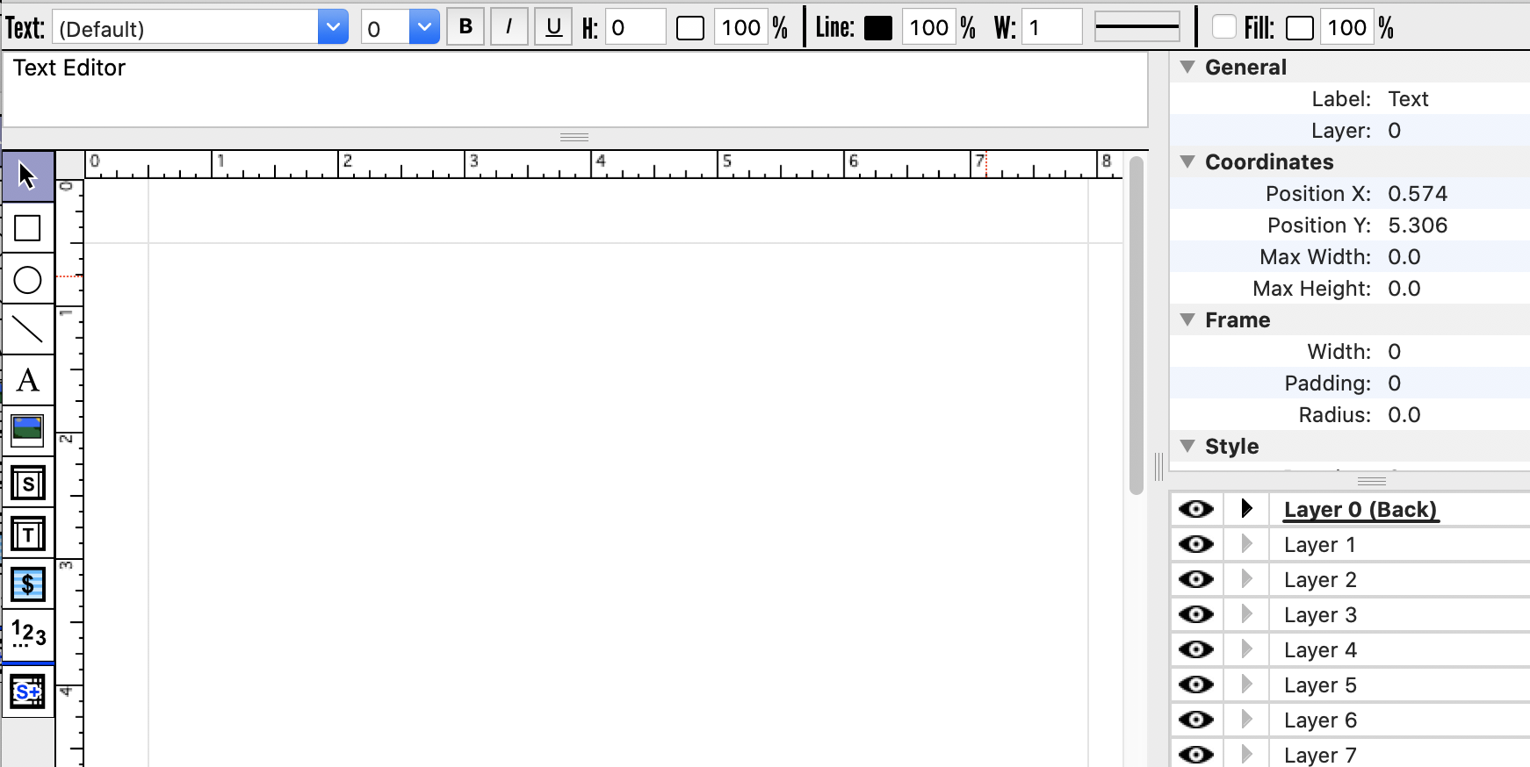
Before Jumping to ParkBench Visual PST
Bold. Italicize, Underline, Line Height between rows - = or +1
Font size 0 =12
Line Color, pixel with and box fills
Draws boxes
Draws circles
Draws lines (makes grids)
Text Tool
Modification Tools
After selecting an object, you can enter SPECIFIC numbers in this area and/or change layers
Insert Pictures/Logo
Standard Object
Transcript Object
Expand and compress by dragging on the three lines
You can click on the black arrow to see all the objects on that layer.
Fees
Sequencing tool
Standard grid tool (newest feature)
X
You can HIDE layers by selecting the CBS EYE
Creation Tools

Slide 9
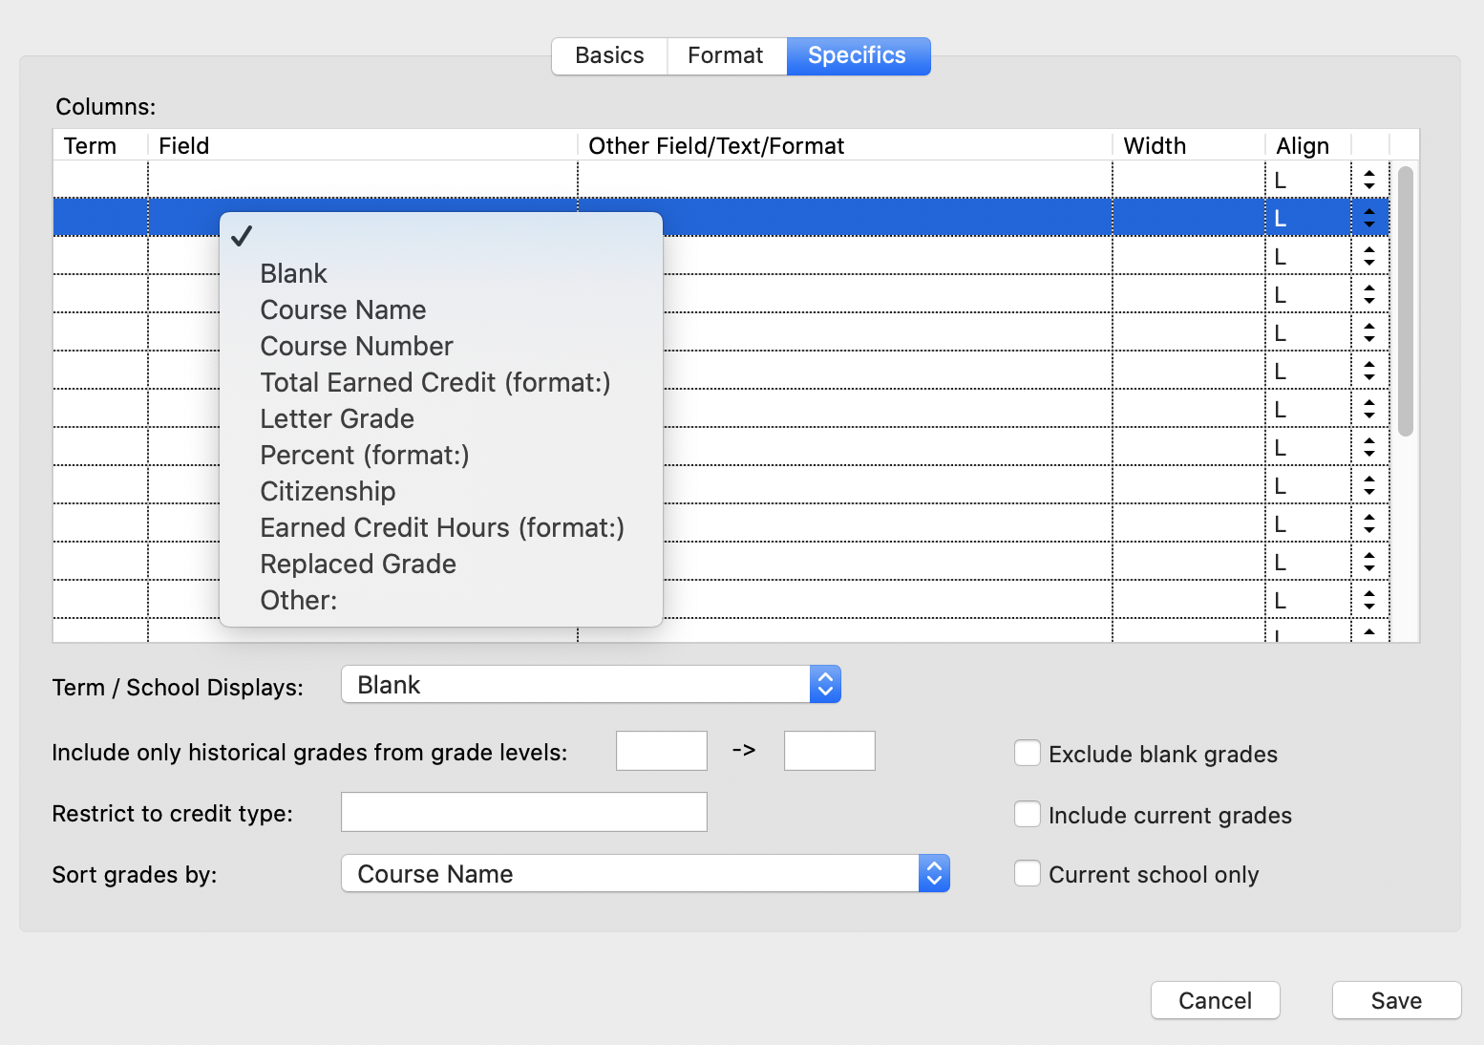
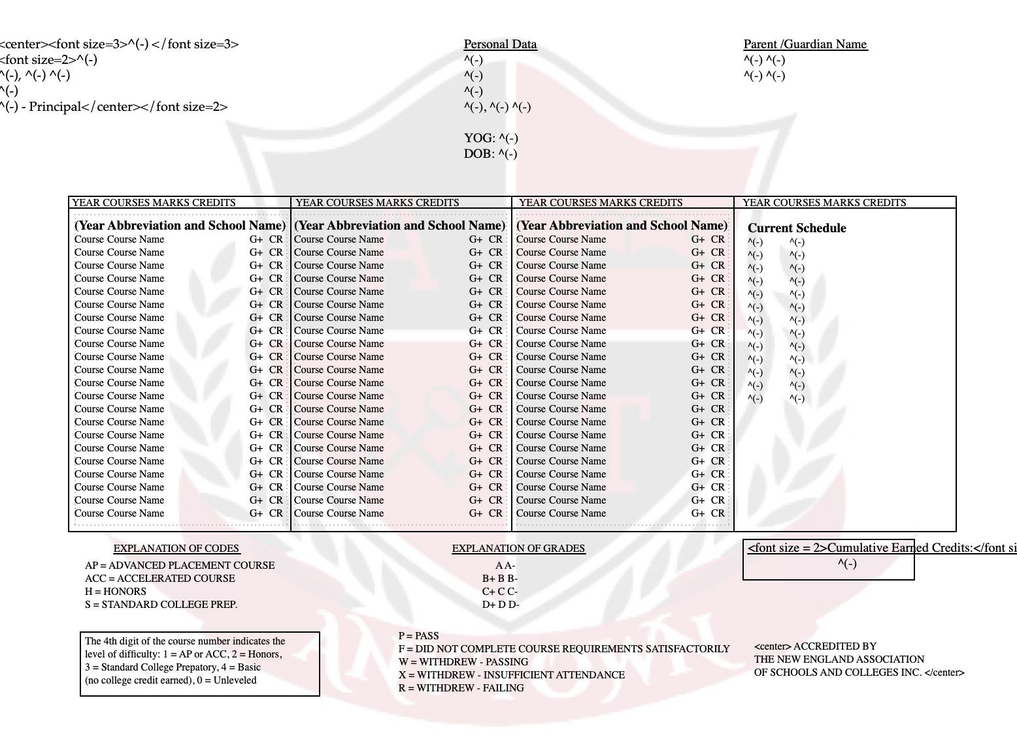
The details are in the SPECIFICS

Slide 10
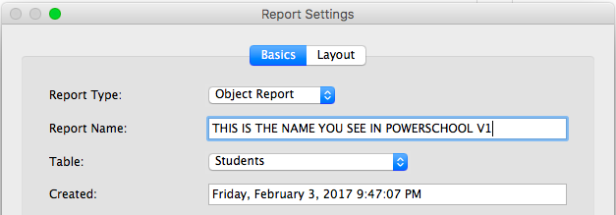
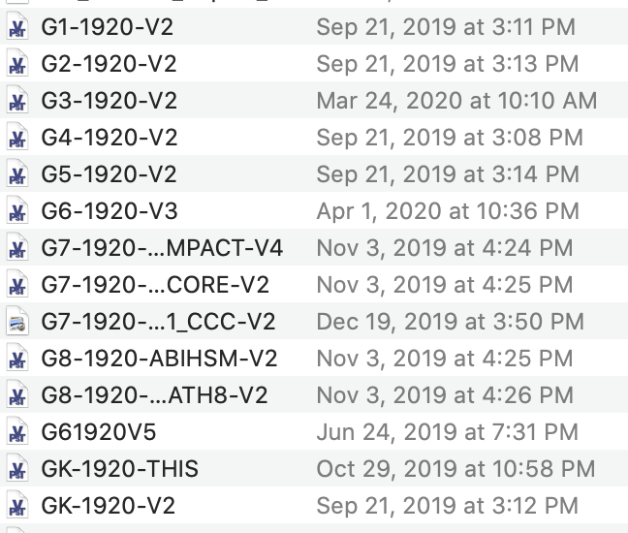
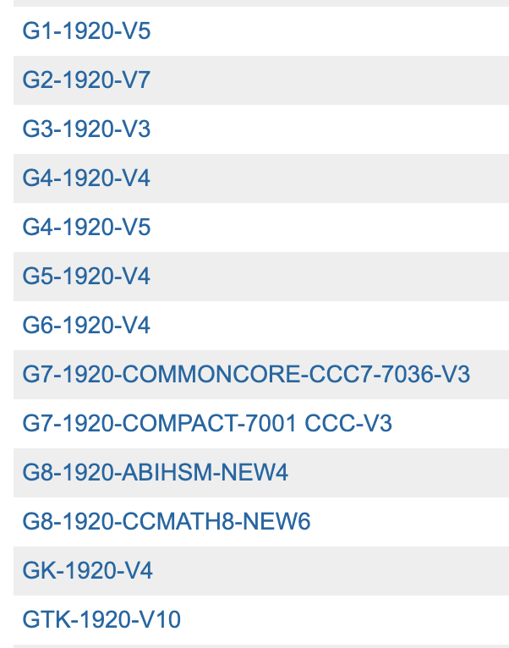
Two Step Saving/Import Process
Visual PST File Names on your computer
Display Names on your server
The name of the report on your computer doesn’t have to match the display name of the report on the PS server!

Slide 11
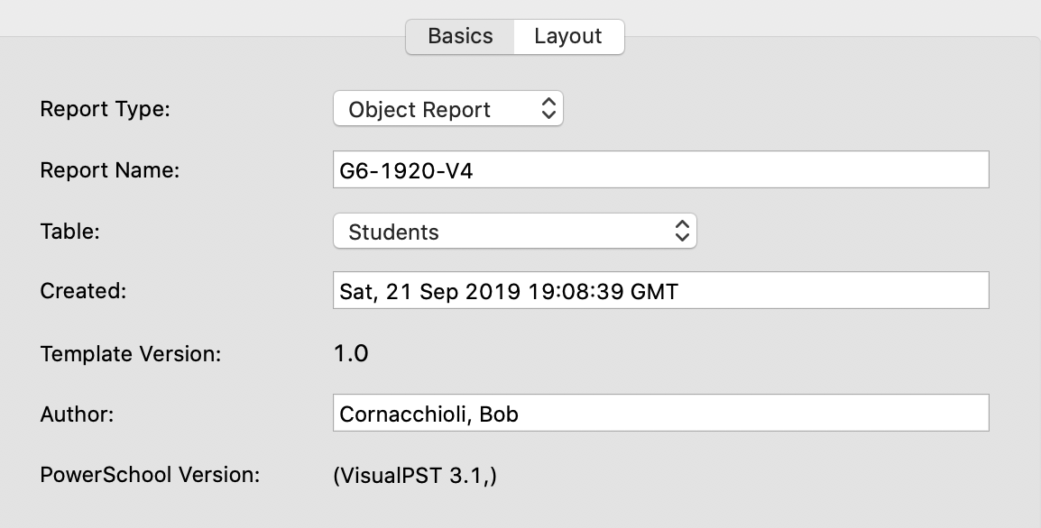
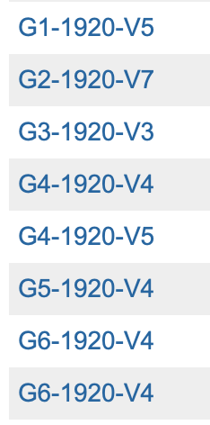
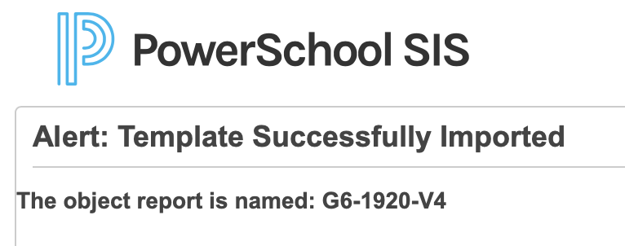
Two Step Saving/Import Process
It’s difficult but not impossible to determine which report is the newest one…
just easier to rename to V5 and re-import!

Slide 12

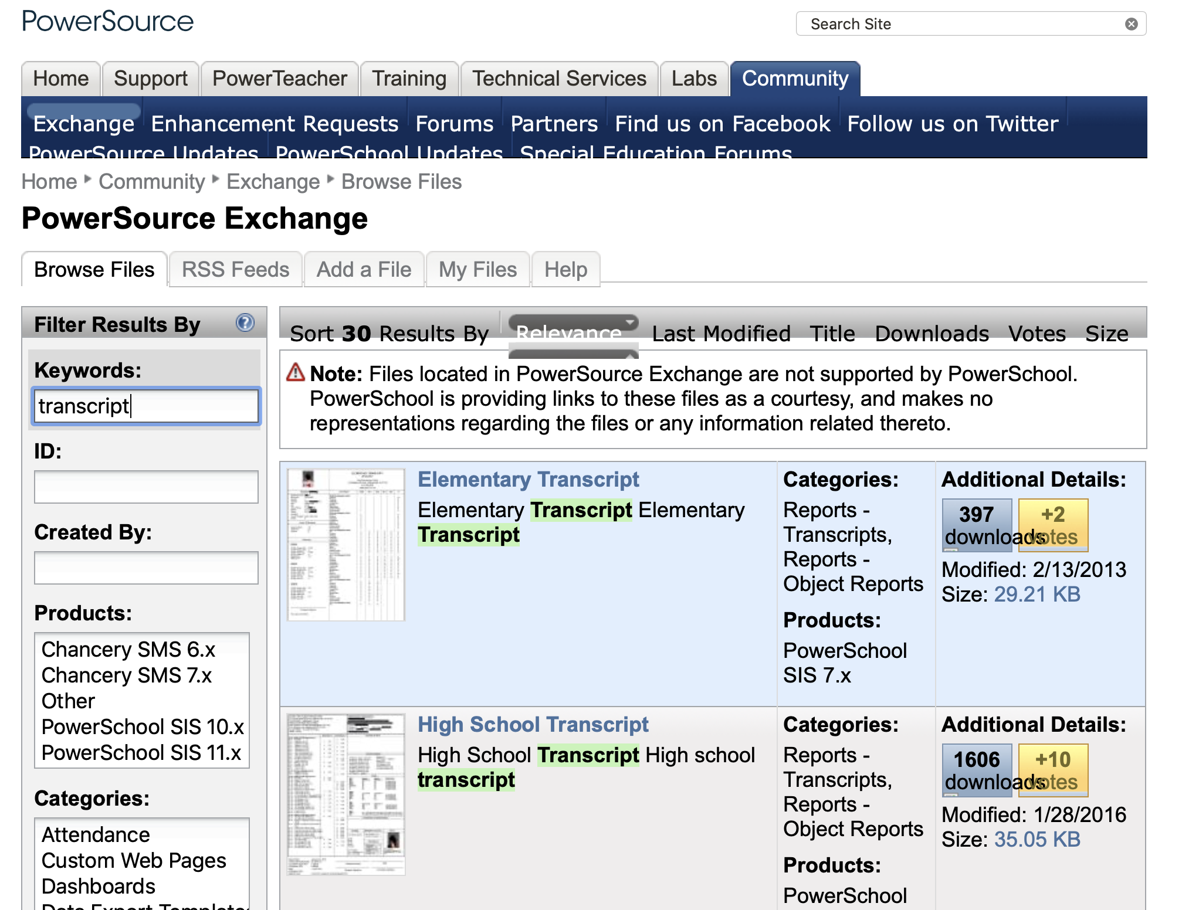
PowerSource
https://support.powerschool.com/exchange/main.action

Slide 13
ANY AND ALL DERO RESOURCES ARE AVAILABLE
TO DOWNLOAD, TWEAK and USE FOR YOUR DISTRICT!
Demo
by Mark
Bill Isard CEO PSISJS
info@psisjs.com www.psisjs.com
Bob Cornacchioli
DERO Technical Services
get2bobc@gmail.com
www.derotechnical.com
Mark Messias
ParkBench Software
mark@parkbenchsoftware.com
www.parkbenchsoftware.com

